Slide 1

Humanities Integration Project:
Becoming: Original Poetry from Different Life Stages (Slides 2-7)
GENED 490 Humanities and the Human Condition
Rachel Snyder
3/30/2025

Slide 2

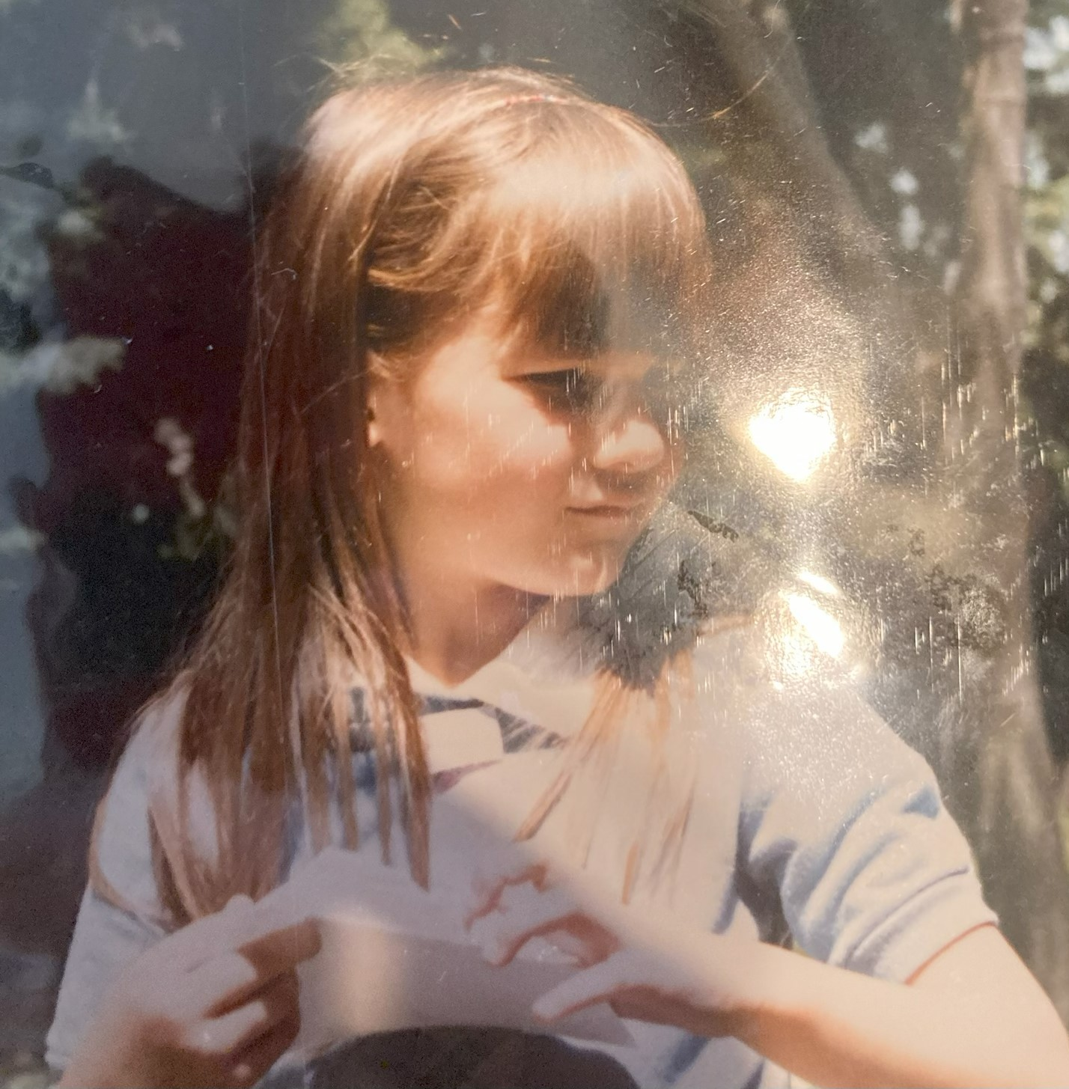
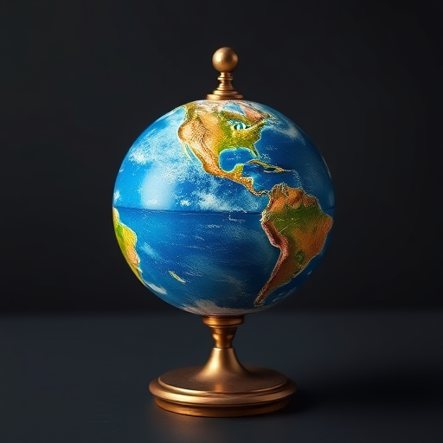
Power is Love
Age 6
The World Spins
Age 9
The world spins
And no one wins
The earth crumbles to nil
Yet generals don’t get their fill
They bomb and bomb until they die
And everyone can hear their cry
Of sorrow and anguish and of pain
It all comes from what they thought was a game
It is a game though, where no one wins
And guess what happens
The world spins.
Maybe sometime in my life
I will be treated somewhat nice.
Maybe sometime in my life
I will have powers from day til night.
But until then, The power is love.
But until then, My power is love.

Slide 3


Untitled Primadonna age 13 age 15
When you bleed in the rain
It never ends
Crimson trails against pale skin
Diluting
Expanding
Diminishing
Until pain is nothing more
Just water falling from the sky
Primadonna sits amid shattered glass
Cats chase mice behind her
Adoring fans kill each other
Music box dancer alone
Music slows but must dance faster
Whirling She/I fall
Primadonna lost her voice

Slide 4
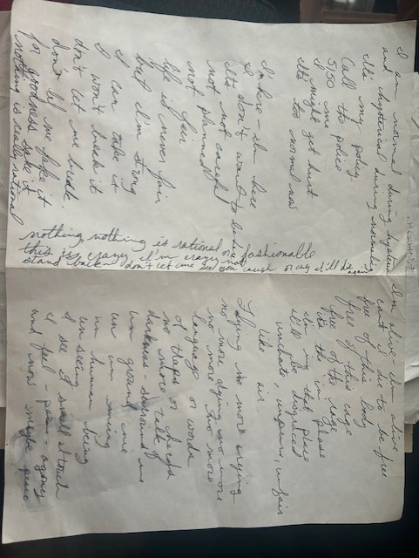
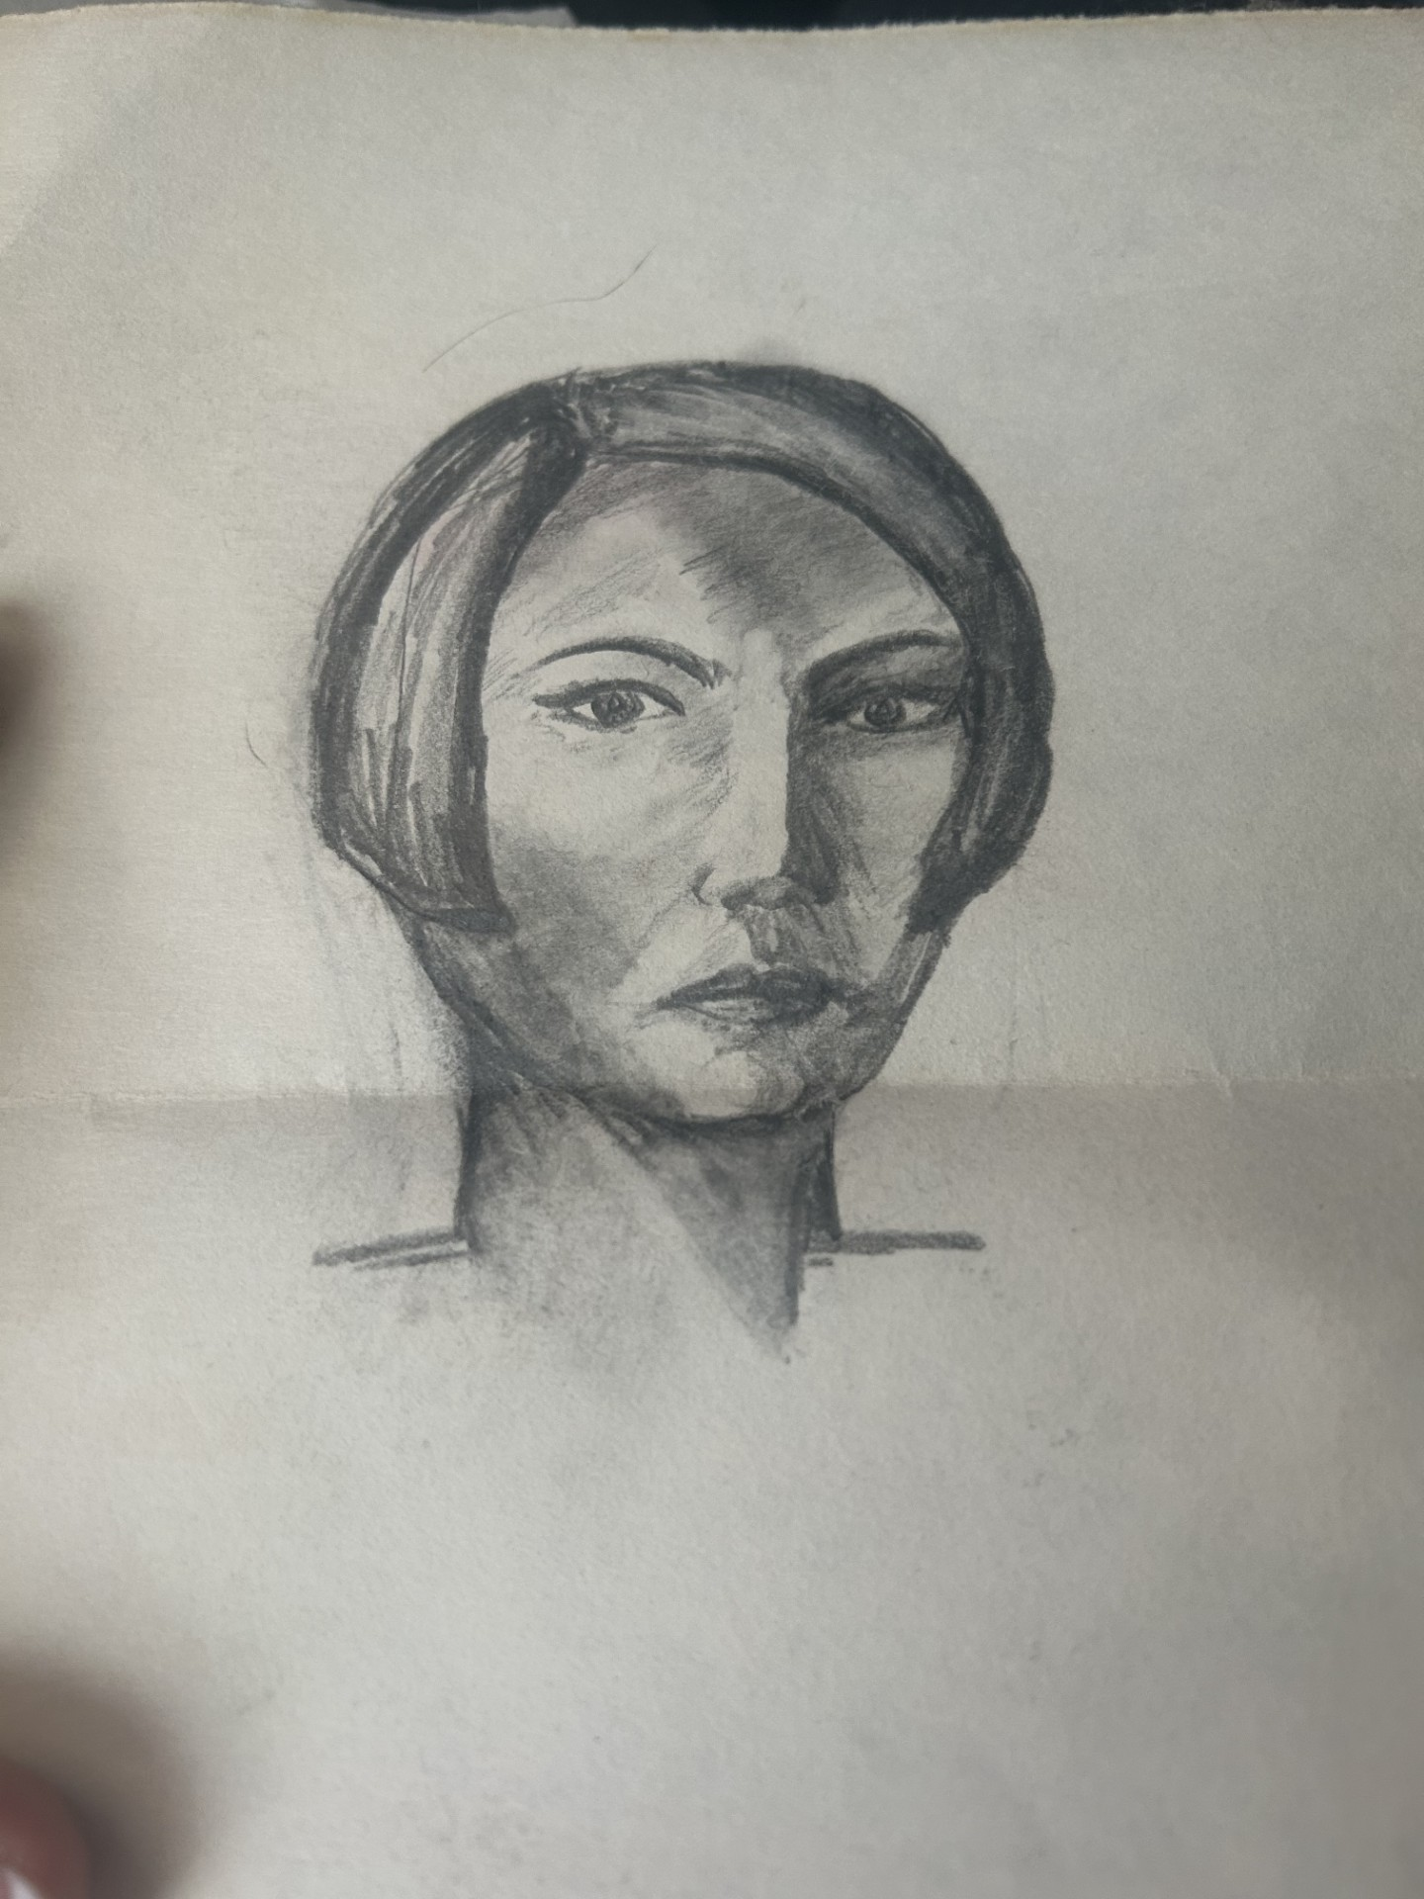
Normal (with self-portrait) age 19

Slide 5
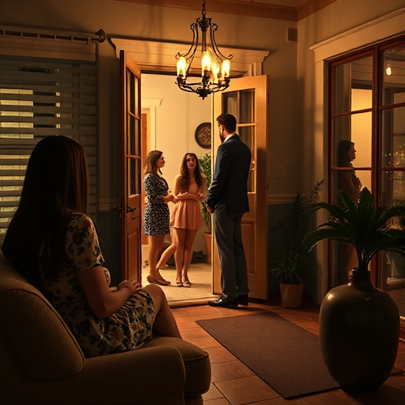
The Stalker Who Stays age 22 (he was 35)
Didn’t want to go on with you no longer trying
I knew you weren’t willing to work anymore
I’m not really rejected just slightly denying
Facing the truth doesn’t get very far
There’ll be bagels and blintzes and butches in the morning
I’ve been here before but I wasn’t me
I’ll be mostly ignored but modestly charming
I’ll serve drinks I won’t drink, smoke borrowed cigarettes
I know these girls, who’ve been with you since
They’re not going to leave till you make them go
I understand what they want, why they haven’t left
Just can’t understand why I’m still here too
Cause you taught me the beauty of sex without meaning
(I’ll explain it tomorrow when I find the words)
I’ll take the closeness of physical proximity
While I suck down my pride and swallow our history
When the lowering of standards comes
With the lowering of shades
Have I beaten the competition
When I’m the stalker who stays?

Slide 6
Covid Haiku 2020
Today we open in radians
A revolving door open/closed/open
Too fast to exit
Barely keeping up
Pain is foreign
Joy too
Social lidocaine sold online
Delivered to the door
Typewriter activists
Shouting in silence
Hidden comfortably in chaos
Woke will autocorrect.
Unseen weightless crush
Avoirdupois of virus
Looting lives and hope

Slide 7
Midway age 47
it is
random coincidence and inexplicable serendipity
i am
intuitive sensing logical hyper-analytical rigid
divergent fragile comfortable strong stretched
respected avoided admired pitied
i become
incongruous judging empathic
sharp amorphous
skeptical curious
open to miraculous

Slide 8
Why Poetry?
I have written poetry since I was young. Poetry has been intensely personal and introspective. South Florida PBS (2024) reminded me of the power of poetry to capture emotion and imagery. Poetry calms the amygdala. I compiled poetry written at different life stages to represent evolving identity. “Power is Love” captures child-like innocence, needing to belong, and acknowledges childhood powerlessness. “World Spins” demonstrates evolving awareness of the world at large, societal problems, and the end of innocence. Teenage and young adult poems demonstrate the struggle for identity. Stalker questions values and mores. COVID-19 era poetry reflects unexpected cultural shifts. “Midway” was written while taking this class, and represents self-reflection prompted by serious illness. The human condition, like poetry, is vulnerable and beautiful and painful, with meaning derived by the person having the experience.

Slide 9
Concepts from Humanities Course
Integration of Humanities in Clinical Practice:
Williams (2019) explains that the humanities is not an “add-on” to healthcare, but necessary for empathy, perspective, and self-reflection. I experienced challenges integrating my vulnerable, artistic, imaginative self with my evidence-based, clinical persona. I aspire to continued opportunities for that integration.
Patient as Storyteller:
Business Innovation Factory & Robert Wood Johnson Foundation (n.d.) taught the importance of using patients’ narratives to understand illness and shape care. Poetry is a form of personal narrative.
Ethical Call to Action:
American Nurses Association (2017) describes the personal and institutional obligation towards fostering resilience to provide ethical care. Humanities offers a counterbalance to laborious and stressful caregiving tasks. Fostering healing environments requires self-regulation and mindfulness.

Slide 10
Caritas Processes
Caritas Process 9: tending to basic human needs. My project explores vulnerability and longing for love as themes that persist from childhood into adulthood. I recognize the poetry as a tool I used to acknowledge and nurture these needs, both in myself and in those I care for. The poetry emphasizes being seen, valued, and supported, especially during times of hardship. This understanding informs my nursing practice by reinforcing the importance of compassionate presence to provide physical, emotional, and spiritual care.
Caritas Process 10: being open to the miraculous and the unknown. I see how my adult voice shifts toward embracing complexity and uncertainty. I’ve learned to value unexpected moments as opportunities for growth. I have learned to be more accepting of the incongruity of human frailty. I rely on curiosity and hope to foster holistic care and resilience.

Slide 11
References:
American Nurses Association. (2017). A call to action: Exploring moral resilience toward a culture of ethical practice. ANA Professional Issues Panel on Moral Resilience. https://www.nursingworld.org/globalassets/docs/ana/ana-call-to-action--exploring-moral-resilience-final.pdf
Business Innovation Factory & Robert Wood Johnson Foundation. (n.d.). The narrative playbook: The strategic use of story to improve care, healing, and health [PDF].
https://samuelmerritt.instructure.com/courses/3521193/discussion_topics/21868027#
South Florida PBS. (2024, 13 June). 14 Ways Art Benefits Your Mind and Body: The Art of Wellbeing [Video]. YouTube. https://www.youtube.com/watch?v=XkDzdVTy1FgLinks to an external site.
William, A. L. (2019). Integrating health humanities, social science, and clinical care. Routledge.

